Slide 1
Chapter 2 Scanning (lexical analysis)

Slide 2

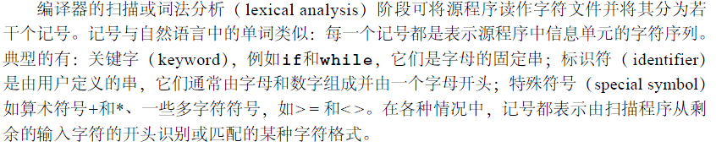
Scanning (lexical analysis)
Reading the source program as a file of characters.
Dividing the file up into tokens.
Tokens: represents a unit of information in the source program.
Examples: keywords, identifiers, arithmetic symbols, multicharacter symbols.将源程序作为字符文件进行读取。 将该文件分割成词法单元。 词法单元：表示源程序中的一个信息单元。 示例：关键字、标识符、算术符号、多字符符号 。

Slide 3
Scanning (lexical analysis)
Since the task performed by the scanner is a special case of pattern matching, we need to study methods of pattern specification and recognition as they apply to the scanning process. These methods are primarily those of regular expressions and finite automata.
However, a scanner is also the part of the compiler that handles the input of the source code, and since this input often involves a significant time overhead, the scanner must operate as efficiently as possible. Thus, we need also to pay close attention to the practical details of the scanner structure.
Emphasis: Methods of pattern specification and recognition
Regular expression
Finite automata

Slide 4
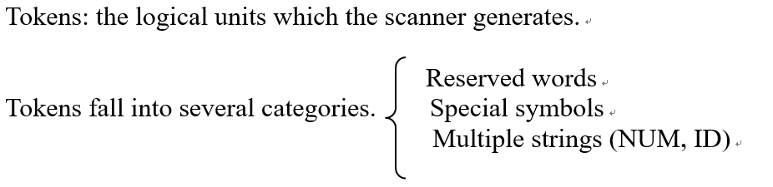
2.1 the scanning process
保留字就具有这个特性
N U M记号可有一个诸如“3 2 7 6 7”的串值属性，它是由5个数字字符组成，但它还会有一个由其值计算所得的真实值3 2 7 6 7组成的数字值属性。在
如P L U S这样的特殊符号记号中，不仅有串值“ +”还有与之相关的真实算术操作+。

Slide 5
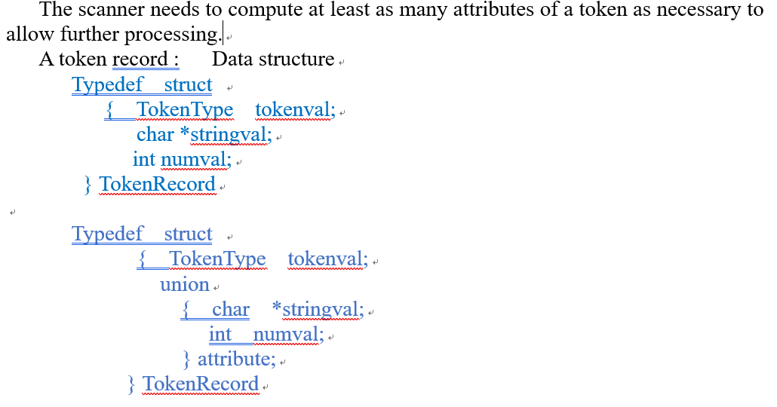
2.1 the scanning process

Slide 6
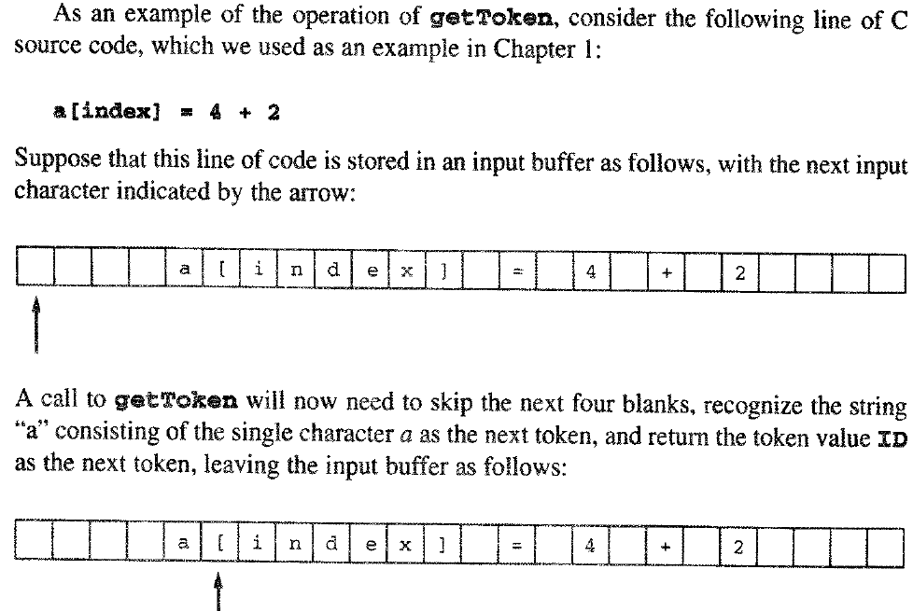

Slide 7
2.2 Regular expression
Regular expressions represent patterns of strings of characters. A regular expression is completely defined by the set of strings that it matches. This set is called the language generated by the regular expression and is written as L(r). Here the word language is used only to mean “set of strings" and has (at least at this stage) no specific relationship to a programming language.
This language depends, first, on the character set that is available. Generally, this will be the set of ASCII characters or some subset of it. Sometimes the set will be more general than the ASCII character set, in which case the set elements are referred to as symbols. This set of legal symbols is called the alphabet and is usually written as the Greek symbol ∑ [sigma].

Slide 8
2.2 Regular expression
正则表达式是对字符串（包括普通字符（例如，a 到 z 之间的字母）和特殊字符（称为“元字符”））操作的一种逻辑公式，就是用事先定义好的一些特定字符及这些特定字符的组合，组成一个“规则字符串”，这个“规则字符串”用来表达对字符串的一种过滤逻辑。正则表达式是一种文本模式，模式描述在搜索文本时要匹配的一个或多个字符串。

Slide 9
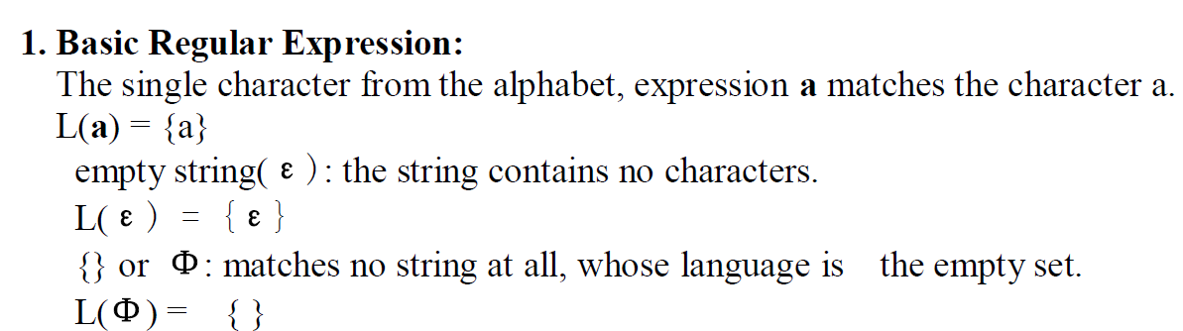
2.2.1 Definition of Regular Expression

Slide 10
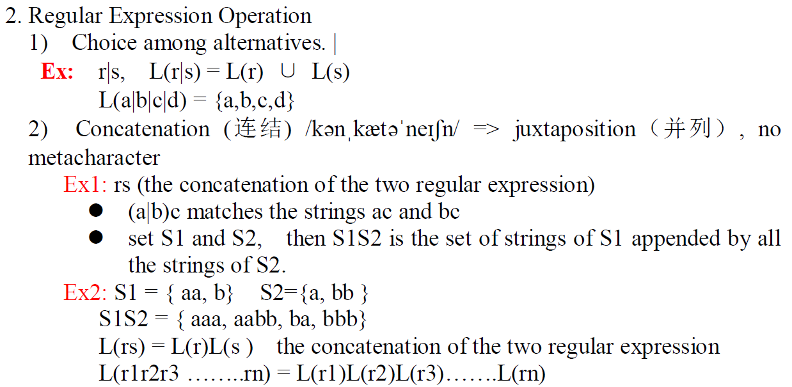

Slide 11
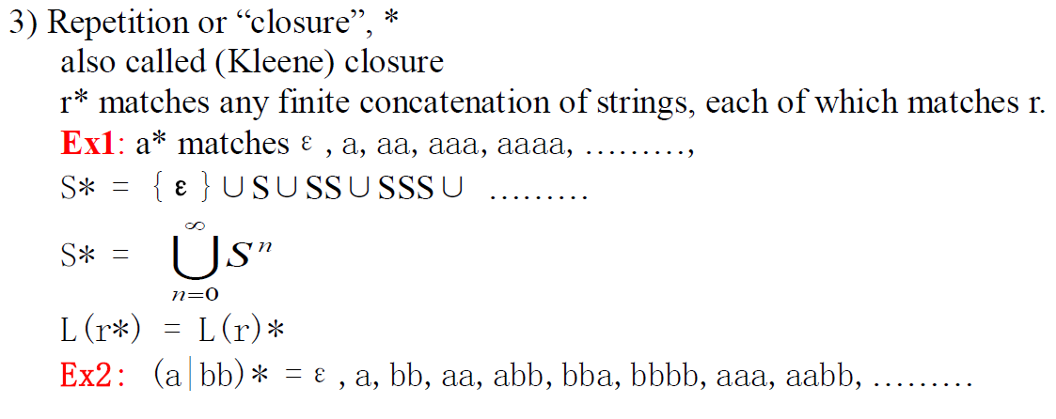
2.2.1 Definition of Regular Expression

Slide 12
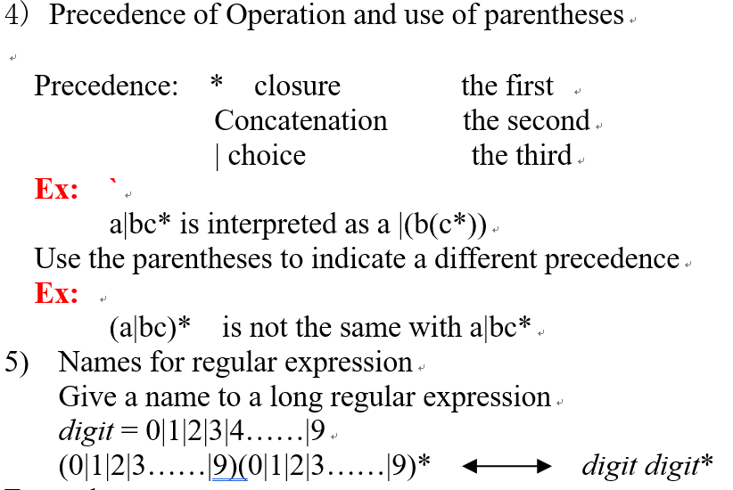
2.2.1 Definition of Regular Expression

Slide 13
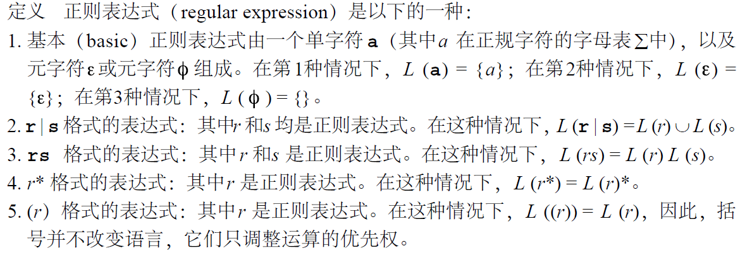
2.2.1 Definition of Regular Expression

Slide 14
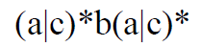
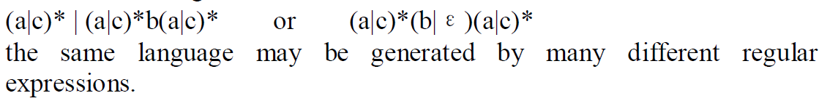
Example
(1) ∑={a, b, c}
the set of all strings over this alphabet that contain exactly one b.
(2) ∑={ a, b, c}
the set of all strings that contain at most one b.

Slide 15
Example
(3) ∑={ a, b}
the set of strings consists of a single b surrounded by the same number of a’s..

Slide 16
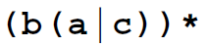
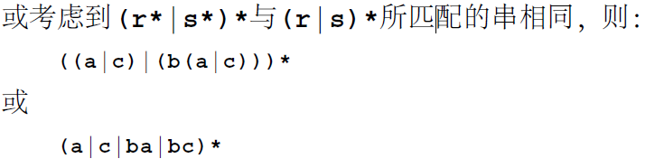
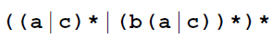
Example
(4) ∑={ a,b,c}
the strings contain no two consecutive b’s
在字母表∑ = {a, b, c}上的串S中，任意两个b 都不相连，所以在任何两个b 之间都至少有一个a 或c。可分几步来构造这个正则表达式，首先是在每一个b 后都有一个a 或c，它写作：
将其与表达式( a | c ) *合并，( a | c ) *是与完全不包含b 的串匹配，则写作：

Slide 17
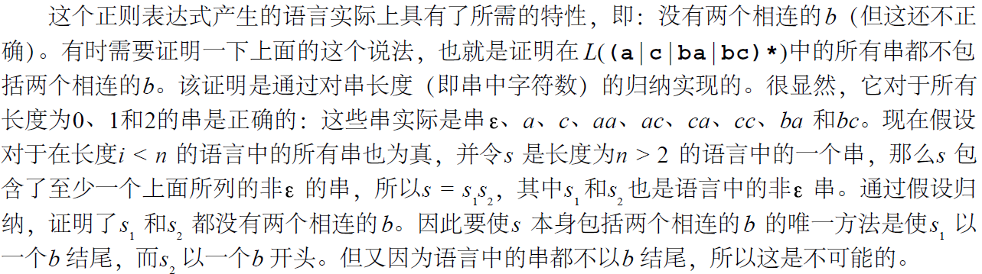
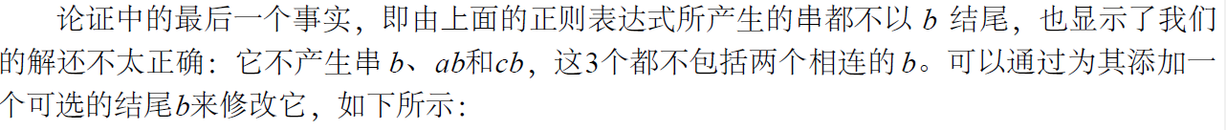

Slide 18
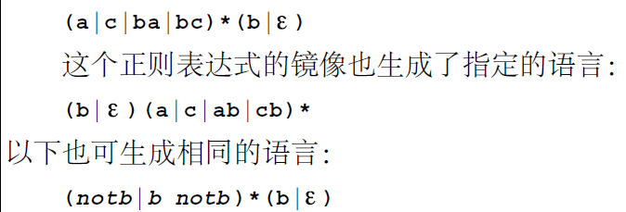
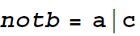
Example
;
其中，

Slide 19
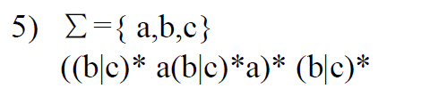
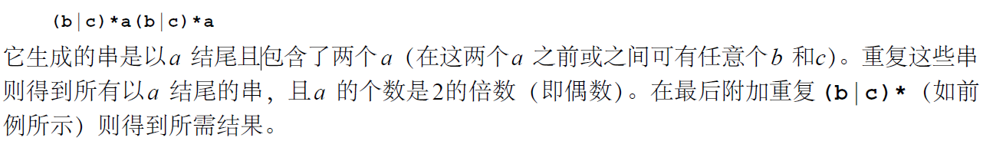
Example
the strings contain an even number(偶数) of a’s

Slide 20
Exercise
(1) L( a(a|b)*b ) =
(2) L(( (ε|a) b*)*) =
(3) L( (a|b)* a(a|b) (a|b) ) =
(4) L( a*ba*ba*ba* ) =

Slide 21
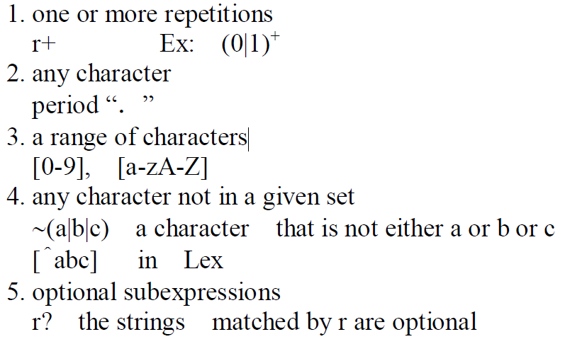
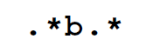
2.2.2 Extensions to Regular Expressions
( 0 | 1 ) ( 0 | 1 ) *
我们经常需要写出字符的范围，例如所有的小写字母或所有的数字。直到现在都是在用表示法 a| b |...|z 来表示小写字母，用0|1 |...|9来表示数字。还可针对这种情况使用一个特殊表示法，但常见的表示法是利用方括号和一个连字符，如[a-z]是指所有小写字母，[0 -9]则指数字。

Slide 22
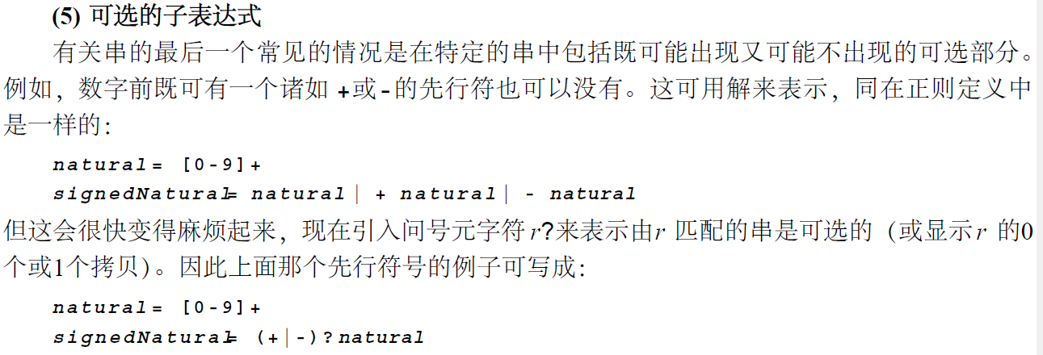
2.2.2 Extensions to Regular Expressions

Slide 23
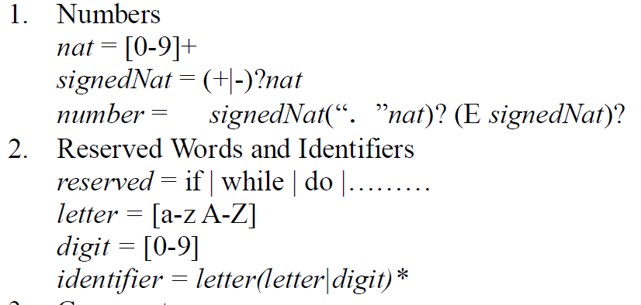
2.2.3 Regular Expressions for Programming Language Tokens

Slide 24
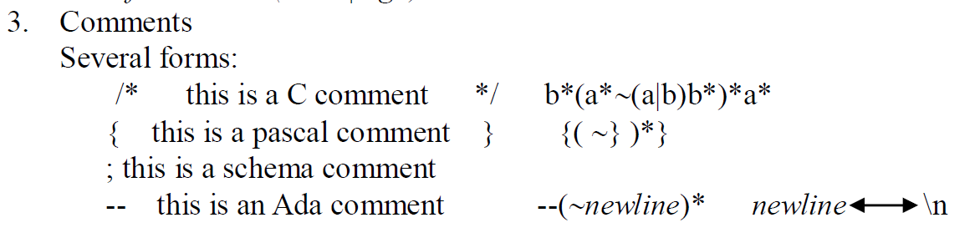
2.2.3 Regular Expressions for Programming Language Tokens
？
ba (~(ab))* ab
由于“非”运算通常限制为只能是单个字符而不能使用字符串。可尝试用~a、 ~ b和~( a | b )为~( a b )写出一个定义来，

Slide 25
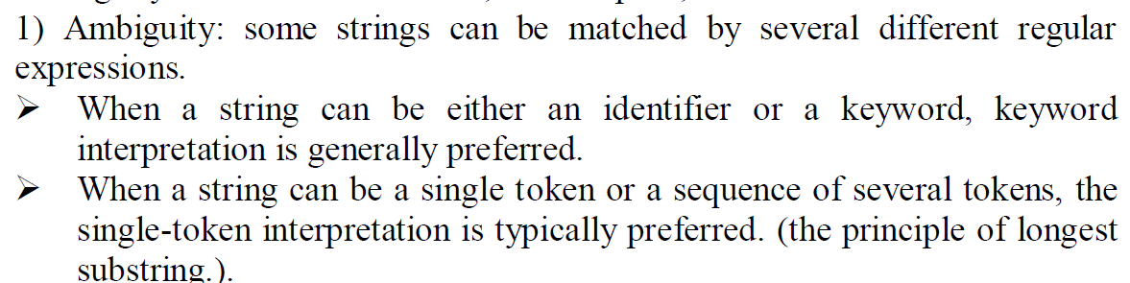
Ambiguity（二义性，奇异性）, White Space
<> ： < ， > 或者是不等于
The principle of longest substring：the longest string of characters that could constitute a single token at any point is assumed to represent the next token.

Slide 26
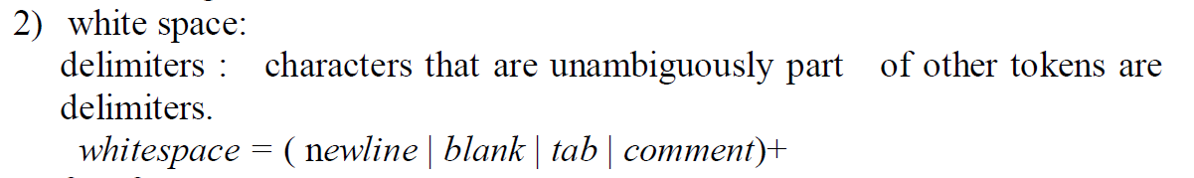
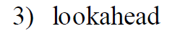
Ambiguity（二义性，奇异性）, White Space
when it encounters a delimiter, it must arrange that the delimiter is not removed from the rest of the input, either by returning it to the input string (“backing up”) or by looking ahead before removing the character from the input.
在语法分析过程中，分析器根据当前已经扫描过的标记流，再加上尚未扫描的标记，确定怎样分析这个句子。如果只看一个尚未处理的标记就能确定怎么进行下一步分析，就叫做Lookahead 1，如果需要看两个才能确定，就叫做Lookahead 2，依此类推.
buffering of input characters , marking places for backtracing (回溯)
Notes:
在语法分析过程中，分析器根据当前已经扫描过的标记流，再加上尚未扫描的标记，确定怎样分析这个句子。如果只看一个尚未处理的标记就能确定怎么进行下一步分析，就叫做Lookahead 1，如果需要看两个才能确定，就叫做Lookahead 2，依此类推.

Slide 27
2.3 Finite Automata
人阅读正则表达式会比较简单，但是机器阅读正则表达式就是一件非常困难的事情了。而且，直接使用正则表达式进行匹配配的话，不仅工作量大，而且速度缓慢。
状态机的这种概念被广泛的应用在各种各样的领域中。软件工程的统一建模语言(UML)有状态图，数字逻辑中也有状态转移图。

Slide 28
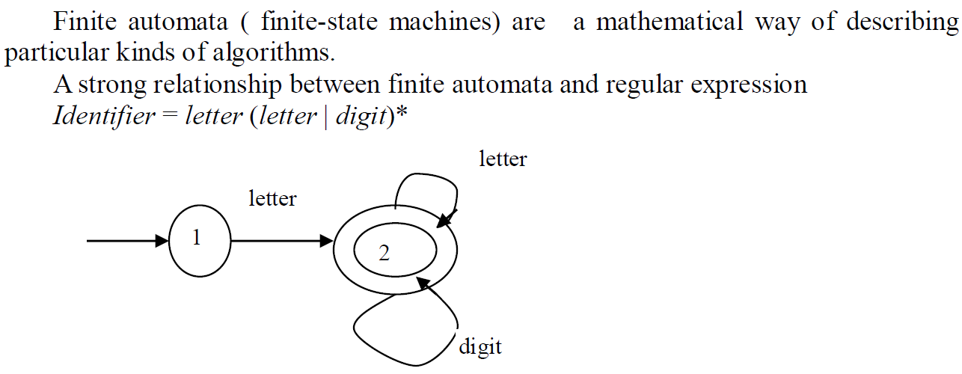
2.3 Finite Automata

Slide 29
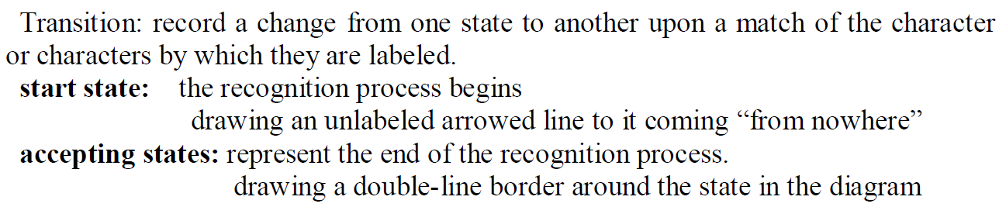
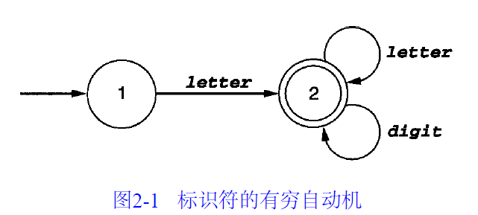
2.3 Finite Automata

Slide 30
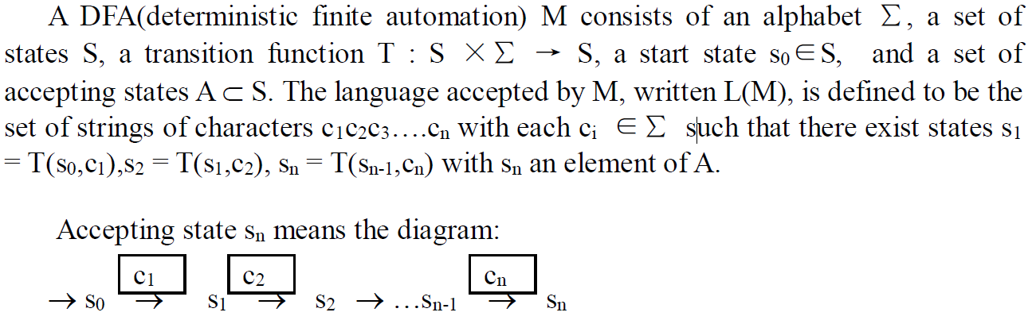
2.3.1 Definite of Deterministic finite automation (DFA)
DFA: automata where the next state is uniquely given by the current state and the current input character.

Slide 31
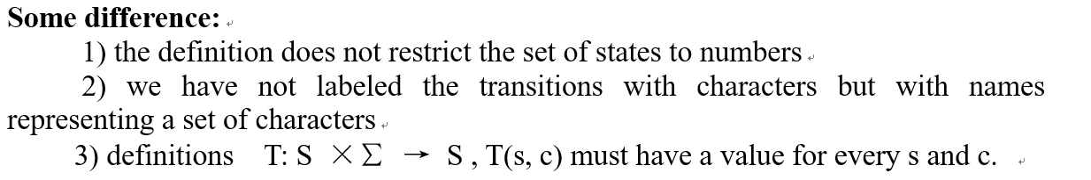
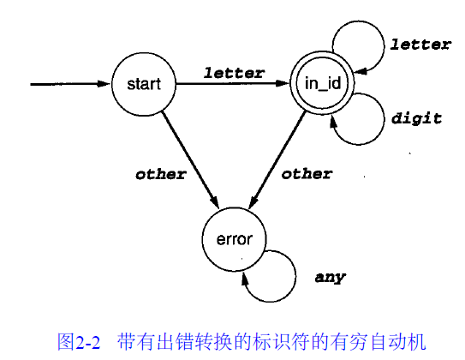
2.3.1 Definite of Deterministic finite automation (DFA)

Slide 32
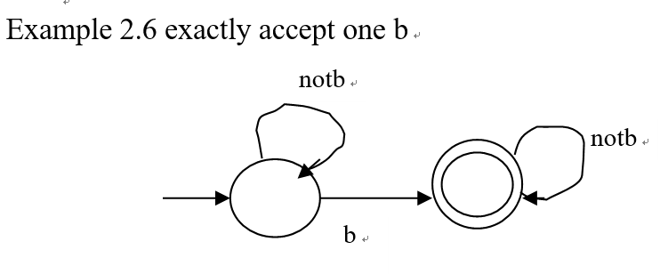
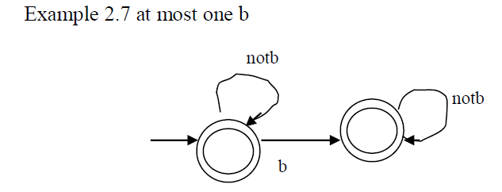
2.3.1 Definite of Deterministic finite automation (DFA)

Slide 33
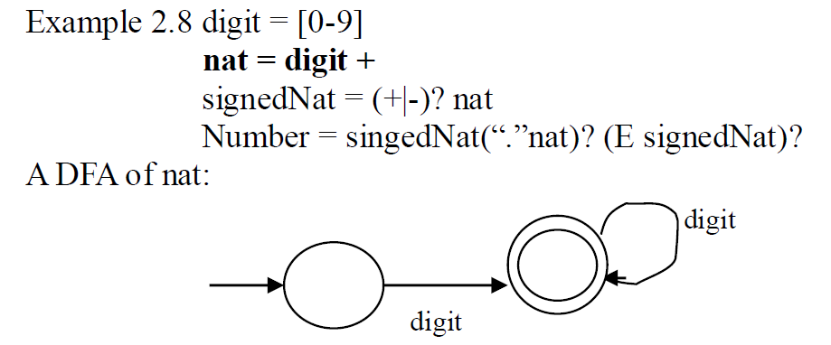
2.3.1 Definite of Deterministic finite automation (DFA)

Slide 34
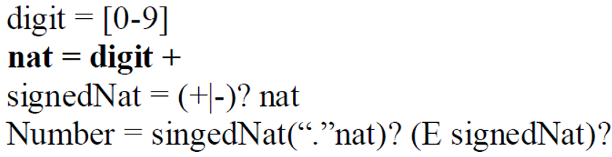
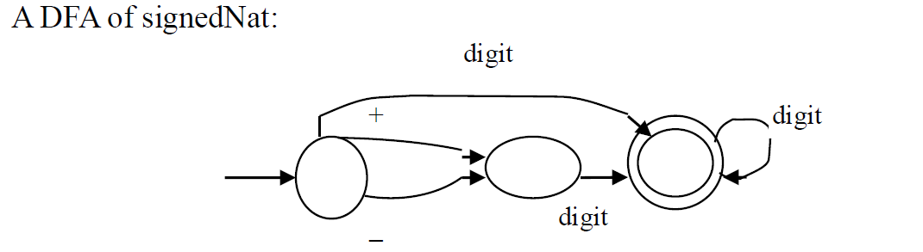
2.3.1 Definite of Deterministic finite automation (DFA)

Slide 35
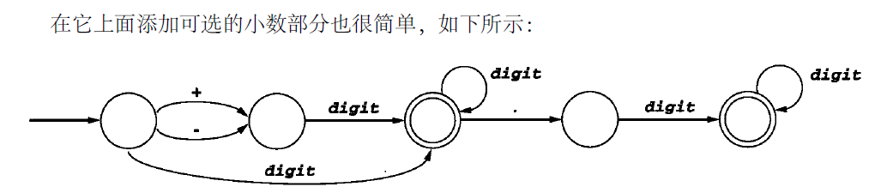
2.3.1 Definite of Deterministic finite automation (DFA)

Slide 36
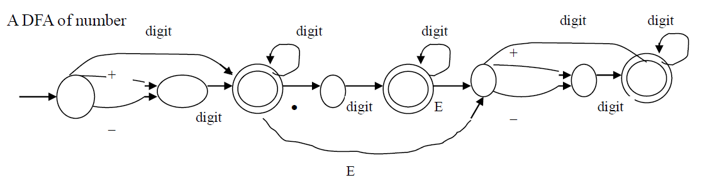
2.3.1 Definite of Deterministic finite automation (DFA)

Slide 37
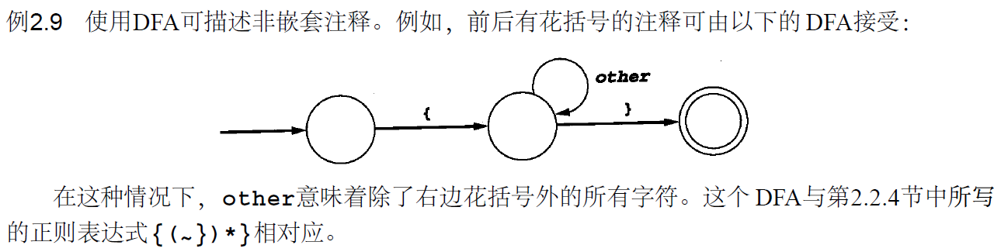
2.3.1 Definite of Deterministic finite automation (DFA)

Slide 38
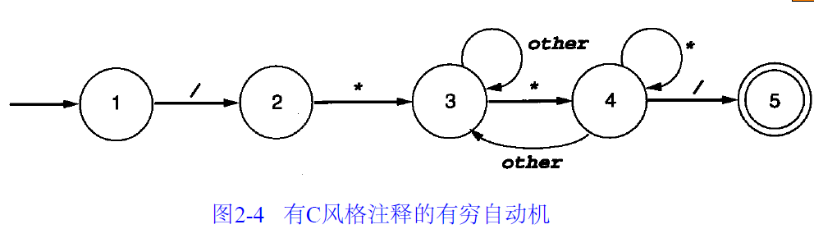
2.3.1 Definite of Deterministic finite automation (DFA)
/ * . . . ( n o * / s ) . . . /

Slide 39
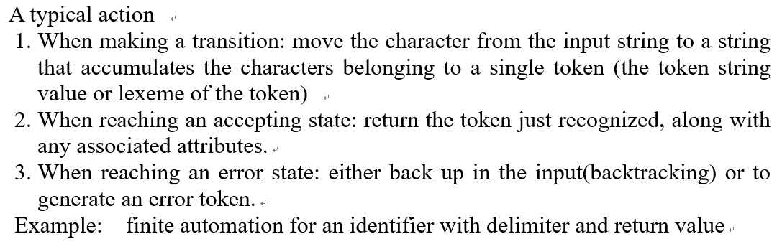
Deterministic finite automation (DFA)
DFA的图表并不能表示出DFA所需的所有东西而仅仅是给出其运算的要点。
Notes:
进行转换时:将字符从输入字符串移动到一个字符串中，该字符串累积了属于单个标记(标记字符串值或标记的词素)的字符。2.当达到接受状态时:返回刚刚识别的令牌，以及任何关联的属性。3.当到达错误状态时:要么在输入中备份(回溯)，要么生成错误令牌。示例:带分隔符和返回值的标识符的有限自动化。

Slide 40
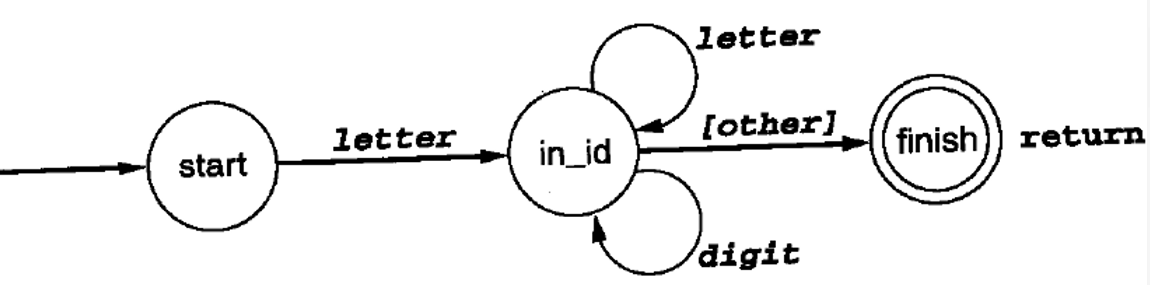
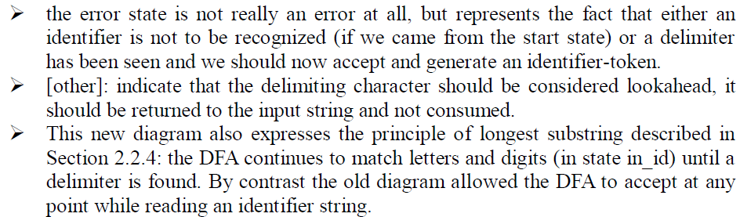

Slide 41
Deterministic finite automation (DFA)
在该图中，other 转换前后都带有方括号，它表示了应先行考虑分隔字符，也就是：应先将其返回到输入串并且不能丢掉。此外在该图中，出错状态已变成接受状态，且没有离开接受状态的转换。因为扫描程序应一次识别一个token并在每一个token识别之后再一次从它的初始状态开始，所以这正是所需要的。

Slide 42
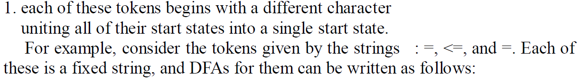
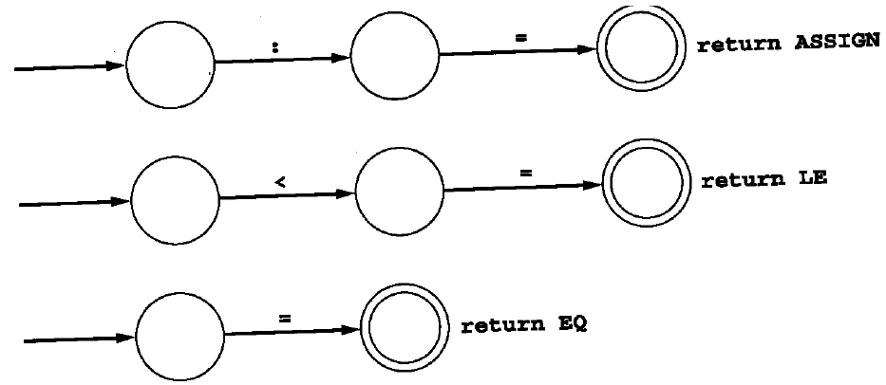
Nondeterministic Automata

Slide 43
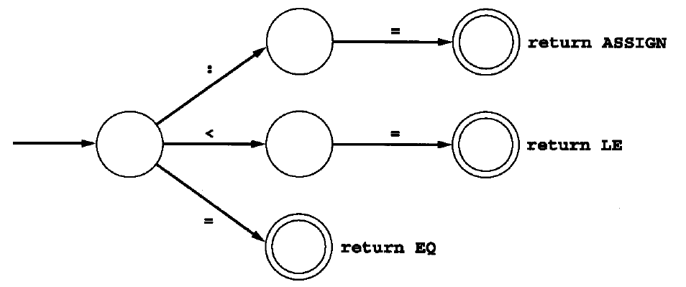
Nondeterministic Automata
we can simply identify their start states to get the following DFA:

Slide 44
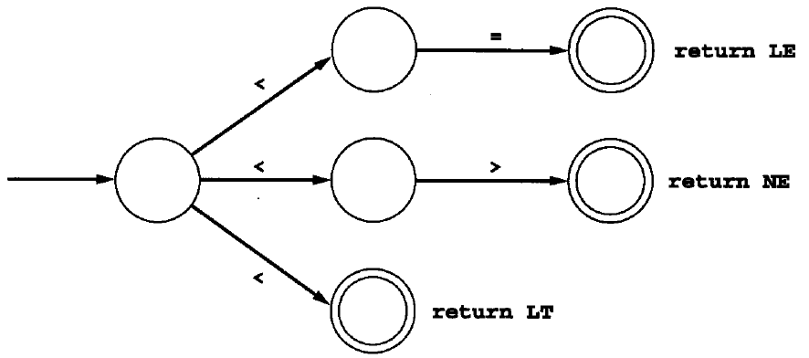
Nondeterministic Automata
2. several tokens that begin with the same character, such as <, <=, and <>,

Slide 45

在理论上是应该能够将所有的记号都合并为具有这种风格的一个巨大的D FA，但是它非常复杂，在使用一种非系统性的方法时尤为如此.
In principle, we should be able to combine all the tokens into one giant DFA in this fashion. However, the complexity of such a task becomes enormous, especially if it is done in an unsystematic way.

Slide 46


Nondeterministic Automata

Slide 47


ε-transitions
ε-transitions are useful in two ways.
好处：
(1) 首先，它们可以不用合并状态就表述另一个选择。例如，记号 :=、<=和=的选择可表述为：为每一个记号合并自动机，如下所示。

Slide 48

ε-transitions
可以清晰地描述出空串的匹配：

Slide 49


NFA (Nondeterministic Finite Automaton)

Slide 50

NFA (Nondeterministic Finite Automaton)
Note

Slide 51




Slide 52
确定与非确定自动机不同
一、转换状态不同
1、确定的有穷自动机：当一个状态面对一个输入符号的时候，所转换到的是一个唯一确定的状态。
2、不确定的有穷自动机：当一个状态面对一个输入符号的时候，它所转换到的可能不只一个状态，可以是一个状态集合。
二、映射不同
1、确定的有穷自动机：将S×Σ映射到S的转换函数。s∈S, a∈Σ, δ(s,a)表示从状态s出发，沿着标记为a的边所能到达的状态。
2、不确定的有穷自动机：将S×Σ映射到2^{S}的转换函数。s∈S, a∈Σ, δ(s,a)表示从状态s出发，沿着标记为a的边所能到达的状态集合。

Slide 53


Slide 54


字符串：abb
regular expression:
(a|ε)b*.
The DFA :

Slide 55


2.3.3 Implementation of finite automata in Code

Slide 56
Drawbacks:
It is ad hoc（特殊的，特别的）—that is, each DFA has to be treated slightly dif­ferently, and it is difficult to state an algorithm that will translate every DFA to code in this way.
The complexity of the code increases dramatically as the number of states rises or, more specifically, as the number of different states along arbi­trary paths rises.

Slide 57




Slide 58
A better method :
using a variable to maintain the current state and writing the transitions as a doubly nested case statement inside a loop, where the first case statement tests the current state and the nested sec­ond level tests the input character.

Slide 59



Slide 60



Slide 61



Generic code
必考

Slide 62



2.4 From Regular Expression To DFAs

Slide 63


2.4.1 from a regular expression to an NFA

Slide 64



r+

Slide 65






Slide 66






Slide 67


Slide 68

2.4.2 from an NFA to a DFA

Slide 69


ε-closure

Slide 70

the Subset Construction:

Slide 71

2.4.2 from an NFA to a DFA

Slide 72




Slide 73



Slide 74



Slide 75

2.4.3 Minimizing the number of states in a DFA
The process we have described of deriving a DFA algorithmically from a regular expression has the unfortunate property that the resulting DFA may be more complex than necessary.

Slide 76



1) 初始分组
分为非接受状态组和接受状态组
{A,B,C,D}和{E}
2) 分割
因为组{E}只包含一个状态，不能再被分割了
另一个{A,B,C,D}
考虑输入a的时候，这些状态都转向B，因此使用以a开头的串无法区分这些状态
考虑输入b的时候，A,B,C转到组{A,B,C,D}的某个成员上，而D转向另一个组的成员E 上，因此将{A,B,C,D}分割成{A,B,C}和{D},得到新一轮状态组{A,B,C}{D}{E}
3) 再次分割
考虑组{A,B,C}
输入b时，A,C到达{A,B,C}中的元素，B到达另一个组中的元素D,因此分割后的状态组为{A,C}{B}{D}{E}
4) 分割完成
{A,C}无法再进行分割，所以最终的状态组就为{A,C}{B}{D}{E}
5) 最小DFA
从状态组中挑选出A,B,D,E作为对应组的代表，其转换函数如图10所示

Slide 77



Slide 78



